Slide 1


X R A Y S
PM REVIEW
G7T9

Slide 2
Content Page
Timeline Overview
Functionalities
Schedule
Iteration Analysis
Metrics
Roles & Responsibilities
Pair Programming Rotation Plan
Q&A

Slide 3
Timeline Overview
Technical Documents & Project Requirements
Discussion
Basic Location Report &
Heatmap
Bootstrap & Basic Location Report
UAT Preparation
3 | 4 | 5 | 6 | 7 | 8 | 9 | 10 | 11 | 12 | 13 | 14 | 15
Login & Bootstrap
Bootstrap
Basic Location Report
Auto Group Detection
Buffer
Final Presentation
Preparation

Slide 4
Functionalities
Tentative Additional Functions | User Account Controls (Password Reset, Change Password) Password Hashing
Framework | No Framework Used Following MVC Design Pattern
Implemented Functions | Login/Logout Bootstrap (Demographics/Location-Lookup/Location)

Slide 5
Schedule
# | Week | Functions | Milestones | PM
1 | 3 – 4 | Documentation |  | Yigang
2 | 5 | Login & Bootstrap |  | Xinyi
3 | 6 – 7 | Bootstrap & Basic Location Report | PM Review (4 Oct) | Rainean
4 | 8 | Basic Location Report & Auto Group Detection |  | Yigang
5 | 9 – 10 | Basic Location Report & Heatmap | In-Class Demo (26 Oct) | Samantha
6 | 11 – 12 | Buffer & UAT Prep | UAT (5 Nov) | Xinyi
7 | 13 – 14 | Final Presentation Preparation | Final Presentation (23 Nov) | Amos

Slide 6
Iteration Analysis

Slide 7
Iteration 1 (2 Weeks)
Discussion
(Day 1 and 2)
Class, Use Case, Sequence and Logical Diagram
(Day 3 to Day 13)
Login
(Day 14)
7

Slide 8
Iteration 1 Analysis
Main Focus:
Project Wiki Discussion
Creating of Technical Documents
PM: Yigang
Samantha & Xinyi
Rainean & Amos
Add On:
Refresher of Java
JSP Introduction

Slide 9
Iteration 2 (1 Week)
Login Page Implementation
(Day 2 to Day 4)
Tech
Documents
(Day 1)
System Testing (Day 4)
Bootstrap Implementation
(Day 2 to Day 4)
9

Slide 10
Iteration 2 Analysis
Main Focus:
Complete Login Page
Bootstrap (Upload Demographics.csv)
PM: Xinyi
Amos & Samantha (Bootstrap)
Rainean & Yigang (Login)
Pitfall:
Login added as a task in the next iteration due to task underestimation

Slide 11
Iteration 3 (2 Weeks)
Slack
Login & Logout
Implementation
(Day 3 to Day 7)
(Day 8 ~ 9)
Design
Review
(Day 1 and 2)
Integration, Testing
and Deploy (Day 11)
Implement BLR (Day 12)
Bootstrap Implementation
(Day 3 to Day 9)
11

Slide 12
Iteration 3 Analysis
Main Focus:
Complete Login & Continue Bootstrap
PM: Rainean
Amos & Xinyi (Bootstrap)
Yigang & Samantha (Login, Bootstrap assist)
Milestone: PM Review
Pitfall:
Bootstrap (Additional Data) will not be completed by this iteration

Slide 13
Iteration 4 (1 Week)
Slack
Complete Auto Group Detection
(Day 2 to Day 4)
(Day 5)
Bootstrap (Add Files) and
Review of Tech Docs
(Day 1)
Integration, Testing
and Deploy (Day 6 ~ 7)
Complete BLR, Top K next place and Top K companions
(Day 2 to Day 5)
13

Slide 14
Iteration 4 Analysis
Main Focus:
Complete Bootstrap
Top K Companions, Top K Next Places Auto Group Detection
PM: Yigang
Rainean & Xinyi (Top K)
Amos & Samantha (Bootstrap, AGD, Top K Assist)
Pitfall:
Basic Location Report will not be completed by Iteration 4

Slide 15
Iteration 5 (2 Weeks)
BLR Breakdown and
Top K Popular Places
(Day 2 to Day 6)
Design
(Day 1 and 2)
Integration, Testing
and Deploy (Day 6 to Day 10)
Heatmap (Day 12 to Day 13)
Heatmap
(Day 2 to Day 6)
15

Slide 16
Iteration 5 Analysis
Main Focus:
BLR & Heatmap
PM: Samantha
Amos & Rainean (Heatmap)
Yigang & Xinyi (BLR, Heatmap Assist)
Milestone: In Class Demo
Add On:
Heatmap displayed in graphical format

Slide 17
Iteration 6 (2 Weeks)
Meeting
(Day 1)
Buffer
(Day 2 to Day 7)
UAT Prep (Day 8 to Day 10)
17

Slide 18
Iteration 6 Analysis
Main Focus:
Buffer and finalize project
PM: Xinyi
Amos & Yigang
Rainean & Samantha
Milestone: UAT
Pitfall: Insufficient Buffer Time
Add On: Implement additional functions that were considered

Slide 19
Iteration 7 (2 Weeks)
Meeting
(Day 1)
Final Presentation Preparation
(Day 2 to Day 10)
Final Presentation
(Day 11)
19

Slide 20
Iteration 7 Analysis
Main Focus:
Final Presentation Preparation
PM: Amos
Xinyi & Samantha
Rainean & Yigang
Milestone: Final Presentation

Slide 21
Metrics

Slide 22
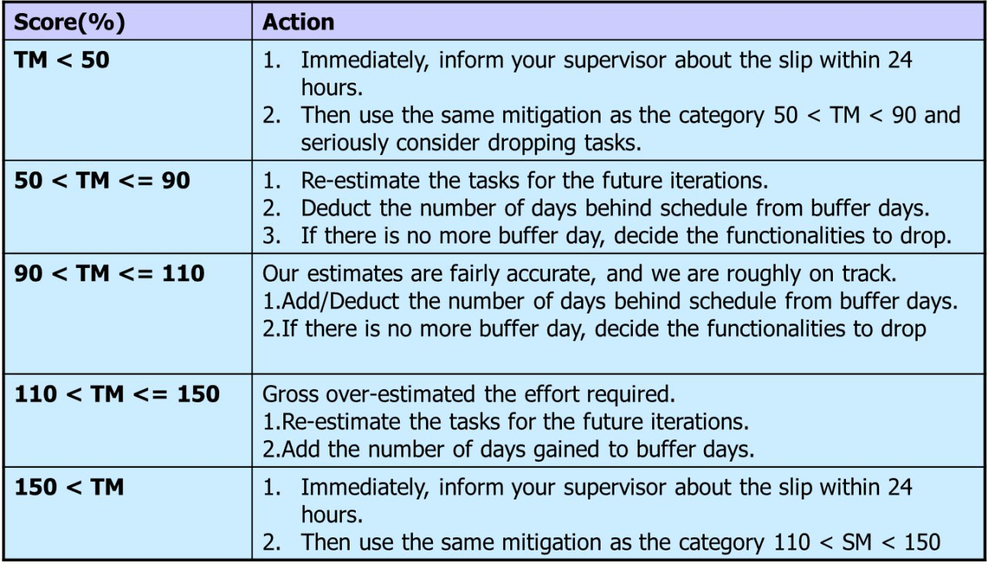
Task Metric

Slide 23
Task Metric
Iteration | Score (%) | Action
1 | 120 | Gross Over Estimation of Effort Technical documents took shorter than expected. We will plan for shorter duration for technical documents in the future which will provide us more time for other tasks.
2 | 80 | Gross Under Estimation of Effort Programming duration took longer than expected. We will take into account the pair programmers’ abilities and plan for longer PP sessions which will provide us with a more realistic view of our timeline.
3 | -

Slide 24
Task Metric
Iteration | Planned Tasks | Completed Tasks
1 | 5 | 6
2 | 5 | 4
3 | 22 | 16 as of now

Slide 25
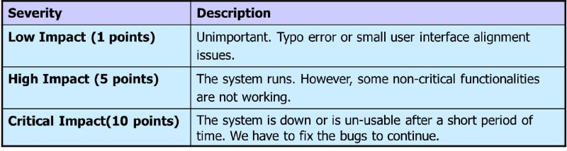
Bug Metric

Slide 26
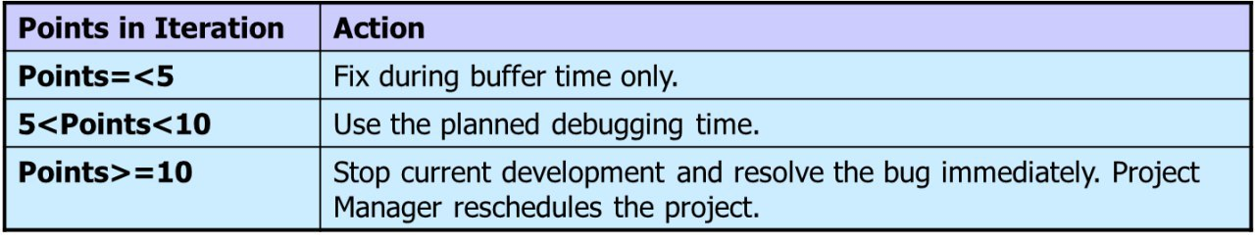
Bug Metric

Slide 27
Bug Metric
Iteration | Score | Action
1 | 0 | None. Continue with development
2 | 0 | None. Continue with development
3 | 16 | Prioritize bugs to be fixed during next PP session.

Slide 28
Bug Metric (Iteration 3)
Feature | Bug Feature |  | Bug Severity | Found By | Date Found
Login | Typo for retrieveUsernameFromEmail() method |  | Low (1) | Yigang | 1st Oct
 | Unable to login with correct username and password |  | High (5) | Yigang
 | Admin gets stuck at a blank authenticate.jsp |  | Critical (10) | Samantha
Bootstrap | AWS bootstrap shows filepath not found error |  |  |  | 5th Oct

Slide 29
Project Planning

Slide 30
Roles & Responsibilities
Project Manager | Pair Programmers
Complete minutes Ensure documents are pushed to git | Code during scheduled pair programming sessions
Proper takeover from previous PM, proper hand over to next PM | Every PP session: Pull at the start, commit during, push at the end
Keep updated with the progress of pair programmers | Inform PM before pushing codes
Ensure the team is on track and detailed schedule is up to date, adjust accordingly | Upload PP picture, submit commit ID on detailed schedule

Slide 31
PM to Milestone Matching
Milestone | PM
PM Review | Rainean
In-Class Demo | Samantha
UAT | Xinyi
Final Presentation | Amos

Slide 32
Pair Programming – Rotation Plan
Week | PM | Pair 1 | Pair 2
Week 3 - Week 4 | Yigang | Amos & Rainean | Samantha & Xinyi
Week 5 | Xinyi | Rainean & Yigang | Amos & Samantha
Week 6- Week 7 | Rainean | Amos & Xinyi | Samantha & Yigang
Week 8 | Yigang | Rainean & Xinyi | Amos & Samantha
Week 9 - Week 10 | Samantha | Amos & Rainean | Xinyi & Yigang
Week 11 - Week 12 | Xinyi | Amos & Yigang | Rainean & Samantha
Week 13 - Week 14 | Amos | Samantha & Xinyi | Rainean & Yigang

Slide 33
Q & A

